Slide 1
Artificial Neural Networks
Parinya Sanguansat

Slide 2
Artificial Neural Networks (ANN)
Neural network inspired by biological nervous systems, such as our brain
Useful for learning real-valued, discrete-valued or vector valued functions
Applied to problems such as interpreting visual scenes, speech recognition, learning robot control strategies
Works well with noisy, complex sensor data such as inputs from cameras and microphones

Slide 3
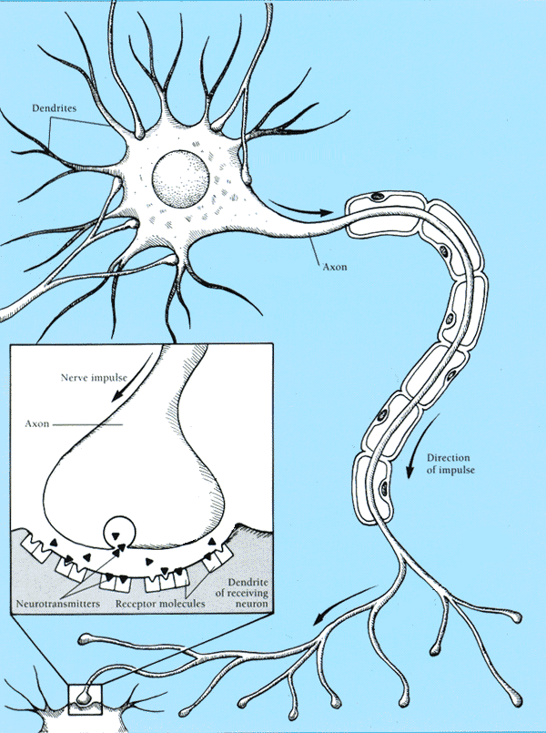
Real Neurons
Cell structures
Cell body
Dendrites
Axon
Synaptic terminals

Slide 4
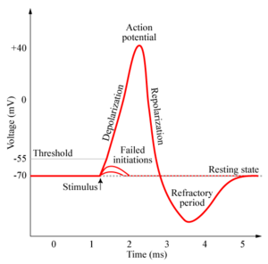
Neural Communication
Electrical potential across cell membrane exhibits spikes called action potentials.
Spike originates in cell body, travels down axon, and causes synaptic terminals to release neurotransmitters.
Chemical diffuses across synapse to dendrites of other neurons.
Neurotransmitters can be excitatory or inhibitory.
If net input of neurotransmitters to a neuron from other neurons is excitatory and exceeds some threshold, it fires an action potential.

Slide 5
Real Neural Learning
Synapses change size and strength with experience.
Hebbian learning: When two connected neurons are firing at the same time, the strength of the synapse between them increases.
“Neurons that fire together, wire together.”

Slide 6
Artificial Neuron Model
Model network as a graph with cells as nodes and synaptic connections as weighted edges from node i to node j, w_{ji}
Model net input to cell as
Cell output is:
1
w₁₂
w₁₃
w₁₄
w₁₅
w₁₆
2
3
4
5
6
o_{j}
1
(T_{j} is threshold for unit j)
0
T_{j}
net_{j}

Slide 7
History of ANN
McCulloch & Pitts (1943) are generally recognized as the designers of the first neural network
Their ideas such as threshold and many simple units combining to give increased computational power are still in use today
In the 50’s and 60’s, many researchers worked on the perceptron
In 1967, Minsky and Papert showed that perceptrons were limited so neural network research died down for about 15 years
In the mid 80’s interest revived (Rumehart, Hinton, Williams), many researchers worked on the backpropagation
1987 – IEEE International Conference on Neural Networks

Slide 8
Applications
Classification
Clustering
Recognition
Prediction
Adaptive filtering
Function Approximation

Slide 9
Perceptron
Use Symmetric hard-limit as the transfer (activation) function
x₁
bias
1
x₂
w₁
w₀
w₂
x₃
∑
o
w₃
:
w_{n}
o_{j}
x_{n}
1
net_{j}
-1
T_{j}

Slide 10
Hyperplane
In 2-D space, we use line to classify the features
In n-D space, we use hyperplane

Slide 11
Perceptron Learning
Initial w_{i} to small value or zero
Until the termination condition is met, Do
For each <(x₁,…x_{n}),t> in training_examples Do
If t_{i}<w_{i}, x_{i}> <= 0, Do w= w + η t_{i}x_{i}
Return w

Slide 12
Perceptron: Step 0
x₂
x₁

Slide 13
Perceptron: Step 1
x₂
x₁

Slide 14
Perceptron: Step 2
x₂
x₁

Slide 15
Perceptron: Step 3
x₂
x₁

Slide 16
Perceptron: Step 4
x₂
x₁

Slide 17
AND Problem
-0.5
∑
x₂
0.5
0.5
x₁
x₂
1
1
1
0.5
1
1
-1
-0.5
-1
x₁
-1
1
-1
1
-0.5
-1
-1
-1
-1.5
-1
-1
X₂ = - X₁+1

Slide 18
OR Problem
0.5
∑
x₂
0.5
0.5
x₁
x₂
1
1
1
1.5
1
1
-1
0.5
1
x₁
-1
1
-1
1
0.5
1
-1
-1
-0.5
-1
-1
X₂ = - X₁-1

Slide 19
XOR Problem
?
∑
x₂
?
?
x₁
x₂
1
x₁
Perceptron cannot solve XOR problem
-1
1
-1

Slide 20
Multi-layer networks
Add the hidden layer between the input and output layers
Output layer
Estimated target
Hidden layer
Feature of feature
Input layer
Feature

Slide 21
Hidden Unit Representations
Trained hidden units can be seen as newly constructed features that make the target concept linearly separable in the transformed space.
On many real domains, hidden units can be interpreted as representing meaningful features such as vowel detectors or edge detectors, etc..
However, the hidden layer can also become a distributed representation of the input in which each individual unit is not easily interpretable as a meaningful feature.

Slide 22
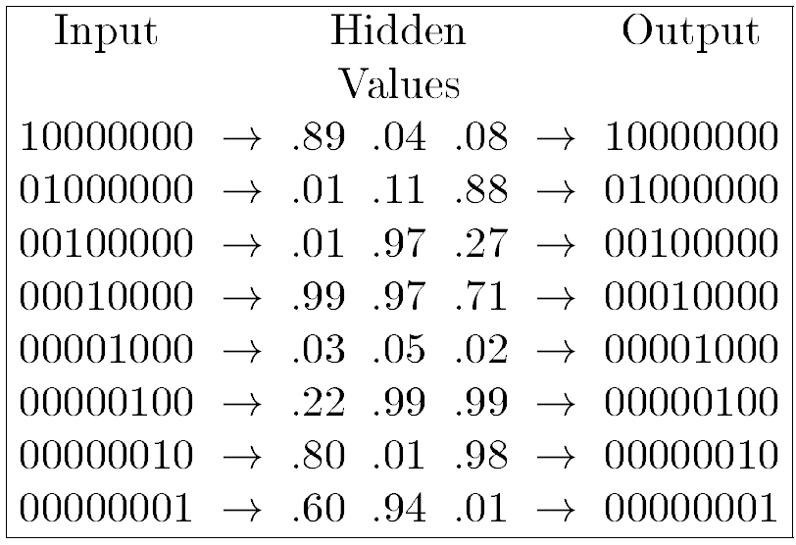
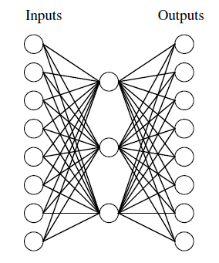
Hidden Unit Representations
The feature of feature

Slide 23
Multi-layer networks
Add the hidden layer between the input and output layers
Output layer
Hidden layer
Input layer

Slide 24
Hidden Unit Representations
The feature of feature
Input
Output
1
Hidden
1
2
2
1
3
3
4
4
2
5
5
6
6
3
7
7
8
8
1 | 0 | 0 | 0 | 0 | 0 | 0 | 0
0 | 1 | 0 | 0 | 0 | 0 | 0 | 0
0 | 0 | 1 | 0 | 0 | 0 | 0 | 0
0 | 0 | 0 | 1 | 0 | 0 | 0 | 0
0 | 0 | 0 | 0 | 1 | 0 | 0 | 0
0 | 0 | 0 | 0 | 0 | 1 | 0 | 0
0 | 0 | 0 | 0 | 0 | 0 | 1 | 0
0 | 0 | 0 | 0 | 0 | 0 | 0 | 1
0.00 | 0.98 | 0.99
0.01 | 0.00 | 0.93
0.99 | 0.00 | 0.98
0.01 | 0.01 | 0.00
0.98 | 0.99 | 0.00
1.00 | 1.00 | 1.00
0.01 | 0.97 | 0.01
0.95 | 0.01 | 0.01
0 | 1 | 1
0 | 0 | 1
1 | 0 | 1
0 | 0 | 0
1 | 1 | 0
1 | 1 | 1
0 | 1 | 0
1 | 0 | 0
1.00 | 0.00 | 0.00 | 0.00 | 0.00 | 0.00 | 0.00 | 0.00
0.00 | 1.00 | 0.00 | 0.00 | 0.00 | 0.00 | 0.00 | 0.00
0.00 | 0.00 | 1.00 | 0.00 | 0.00 | 0.00 | 0.00 | 0.00
0.00 | 0.00 | 0.00 | 1.00 | 0.00 | 0.00 | 0.00 | 0.00
0.00 | 0.00 | 0.00 | 0.00 | 1.00 | 0.00 | 0.00 | 0.00
0.00 | 0.00 | 0.00 | 0.00 | 0.00 | 0.99 | 0.00 | 0.00
0.00 | 0.00 | 0.00 | 0.00 | 0.00 | 0.00 | 1.00 | 0.00
0.00 | 0.00 | 0.00 | 0.00 | 0.00 | 0.00 | 0.00 | 1.00

Slide 25
XOR Problem: Layer 0
x₂
0.5
∑
1
1
1
x₁
∑
∑
-1
1
-1
-1
-1
1
1
x₁
x₂

Slide 26
XOR Problem : Layer 1
v₂
0.5
∑
v₁
1
1
v₂
1
v₁
∑
∑
-1
1
-1
-1
-1
1
1
x₁
x₂

Slide 27
XOR Problem : Layer 2
0.5
∑
v₁
1
1
v₂
∑
∑
-1
1
-1
-1
1
1
x₁
x₂

Slide 28
Exercise 1
 | x1 | x2
A | 0.1 | 1
B | -0.5 | 0.3
C | 0.4 | -1
D | 0.25 | 0.25
0.5
∑
-1
1
0.2
∑
0.3
∑
-1
-1
1
1
x₁
x₂

Slide 29
Linear unit
Use linear equation as the transfer (activation) function
x₁
bias
1
x₂
w₁
w₀
w₂
x₃
∑
o
w₃
:
w_{n}
o_{j}
x_{n}
0
net_{j}

Slide 30
Gradient Descent
To find a local minimum of a function using gradient descent, one takes steps proportional to the negative of the gradient of the function at the current point.
Other names: Steepest descent
Hill climbing on continuous space
Least Mean Square (LMS) when cannot compute exactly the gradient vector
Other names: Delta rule, Adaline rule, Widrow-Hoff rule
The Mean Square Error (MSE) is used to estimate the gradient vector

Slide 31
Mean Square Error (MSE)
Error = Actual value – Estimated value
In ANN
Estimated value = Output
Actual value = Target
Error = Target – Output
Error of ???

Slide 32
Estimate the gradient from error
Partial derivatives of e(w) by w

Slide 33
Gradient Descent Algorithm
Gradient-Descent(training_examples, η)
Each training example is a pair of the form <(x₁,…x_{n}),t> where (x₁,…x_{n}) is the vector of input values, and t is the target output value, η is the learning rate (e.g. 0.1)
Initialize each w_{i} to some small random value
Until the termination condition is met, Do
Initialize each Δw_{i} to zero
For each <(x₁,…x_{n}),t> in training_examples Do
Input the instance (x₁,…x_{n}) to the linear unit and compute the output o
For each linear unit weight w_{i} Do Δw_{i}= Δw_{i} + η (t-o) x_{i}
For each linear unit weight w_{i} Do w_{i}=w_{i}+Δw_{i}
Return weight
???

Slide 34
Incremental Stochastic Gradient Descent
Batch mode : gradient descent
w = w - η ∇e_{D}(w) over the entire data D
e_{D} (w)=1/2 Σ_{d} (t_{d}-o_{d})²
Incremental mode: gradient descent
w = w - η ∇e_{d}(w) over individual training examples d
e_{d} (w)=1/2 (t_{d}-o_{d}) ²
Incremental Gradient Descent can approximate Batch Gradient Descent arbitrarily closely if η is small enough

Slide 35
Gradient Descent Algorithm (Incremental)
Gradient-Descent(training_examples, η)
Each training example is a pair of the form <(x₁,…x_{n}),t> where (x₁,…x_{n}) is the vector of input values, and t is the target output value, η is the learning rate (e.g. 0.1)
Initialize each w_{i} to some small random value
Until the termination condition is met, Do
Initialize each Δw_{i} to zero
For each <(x₁,…x_{n}),t> in training_examples Do
Input the instance (x₁,…x_{n}) to the linear unit and compute the output o
For each linear unit weight w_{i} Do w_{i}=w_{i}+ η (t-o) x_{i}
Return weight
Frequently update (per sample) → avoid local trap

Slide 36
Perceptron vs. Gradient Descent Rule
Perceptron learning rule guaranteed to succeed if
Training examples are linearly separable
Sufficiently small learning rate η
Linear unit training rules uses gradient descent
Guaranteed to converge to hypothesis with minimum squared error
Given sufficiently small learning rate η
Even when training data contains noise
Even when training data not separable by H

Slide 37
Presentation of Training Examples
Presenting all training examples once to the ANN is called an epoch.
In incremental stochastic gradient descent training examples can be presented in
Fixed order (1,2,3…,M)
Randomly permutated order (5,2,7,…,3)
Completely random (4,1,7,1,5,4,……)
1 epoch of Perceptron = 1 traning sample
1 epoch of Gradient descent = All traning samples

Slide 38
Sigmoid unit
Use logistic function as the transfer (activation) function
x₁
bias
1
x₂
w₁
w₀
w₂
x₃
∑
y
w₃
:
w_{n}
o_{j}
x_{n}
0
net_{j}

Slide 39
Why sigmoid?
The signum function is discontinuous at zero, undifferentiable
We need nonlinear differentiable function that similar to signum function
Moreover, the derivative is easily to compute

Slide 40
Backpropagation
Learn the weights for a multilayer network
Use gradient descent to minimize the error between output and target
Redefine the error of a multiple outputs

Slide 41
Backpropagation Notation
The i-th input to unit j:
The weight of i-th input to unit j:
The weighted sum of inputs for unit j:
The output computed by unit j:
The target output for unit j:
The sigmoid function:
The set of units in the final layer of the network:
The set of units whose immediate inputs include the output of unit j:
The error of unit j:

Slide 42
Derivation of Backpropagation
The error on training example d:
Chain rule:
Output:
Hidden:

Slide 43
Backpropagation Algorithm
Backpropagation(training_example, η,n_{in}, n_{out,} n_{hidden})
Create a feed-forward network with n_{in}, n_{out,} n_{hidden}
Initialize all network weights to small random number
[-0.5,0.5]
Until the termination condition is met, Do
For each <(x₁,…x_{n}),t> in training_examples Do
Propagate the input forward through the network:
Input the instance (x₁,…x_{n}) to the network and compute the output of every units
Propagate the error backward through the network:
For each output unit k, Do
For each hidden unit h, Do
Update each network weight:
Return weight

Slide 44
Error Backpropagation
First calculate error of output units and use this to change the top layer of weights.
Current output: o_{k}=0.2
target: t_{k}=1.0
Error δ_{k} = o_{k}(1–o_{k})(t_{k}–o_{k})
0.2(1–0.2)(1–0.2)=0.128
Output layer
Hidden layer
Update weights into k
Input layer

Slide 45
Error Backpropagation
Next calculate error for hidden units based on errors on the output units it feeds into.
Output layer
Hidden layer
Input layer

Slide 46
Error Backpropagation
Finally update bottom layer of weights based on errors calculated for hidden units.
Output layer
Hidden layer
Update weights into h
Input layer

Slide 47
Comments on Backpropagation
Not guaranteed to converge to zero training error, may converge to local optima or oscillate indefinitely.
To avoid local-minima problems, Run several trials starting with different random weights (random restarts)
Take results of trial with lowest training set error.
Build a committee of results from multiple trials (possibly weighting votes by training set accuracy).
However, in practice, does converge to low error for many large networks on real data.
Many epochs (thousands) may be required, hours or days of training for large networks.

Slide 48
Local optima
It is the trap for gradient descent
Local
Global

Slide 49
Momentum
Add momentum to avoid the local optima
[0,∞)
[0,1]
Local
Global

Slide 50
Representational Power
Boolean functions: Any boolean function can be represented by a two-layer network with sufficient hidden units.
Continuous functions: Any bounded continuous function can be approximated with arbitrarily small error by a two-layer network.
Sigmoid functions can act as a set of basis functions for composing more complex functions, like sine waves in Fourier analysis.
Arbitrary function: Any function can be approximated to arbitrary accuracy by a two hidden layer.

Slide 51
Over-fitting Prevention
Running too many epochs can result in over-fitting.
Keep a hold-out validation set and test accuracy on it after every epoch. Stop training when additional epochs actually increase validation error.
To avoid losing training data for validation:
Use internal 10-fold CV on the training set to compute the average number of epochs that maximizes generalization accuracy.
Train final network on complete training set for this many epochs.
error
on test data
on training data
0
# training epochs

Slide 52
Determining the Best Number of Hidden Units
Too few hidden units prevents the network from adequately fitting the data.
Too many hidden units can result in over-fitting.
Use internal cross-validation to empirically determine an optimal number of hidden units.
error
on test data
on training data
0
# hidden units

Slide 53
Example: XOR problem
Feed Forward Backpropagation for XOR problem

Slide 54
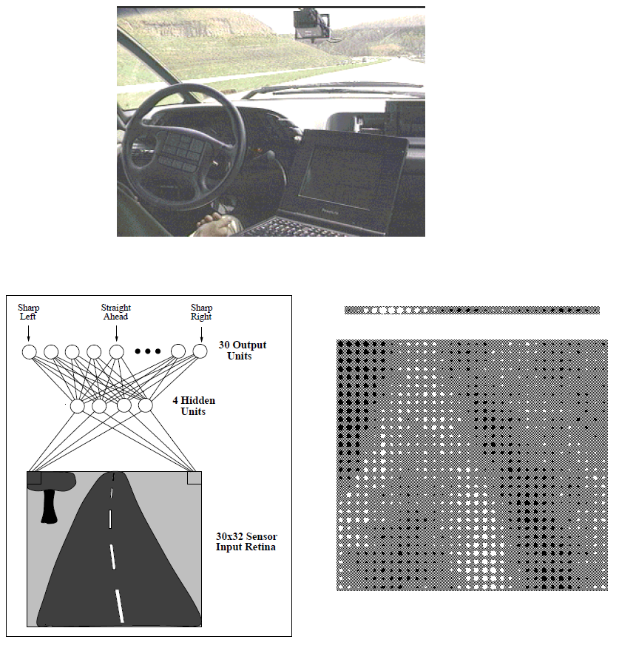
Example: ALVINN
Steering on highway 90 mile/hour

Slide 55
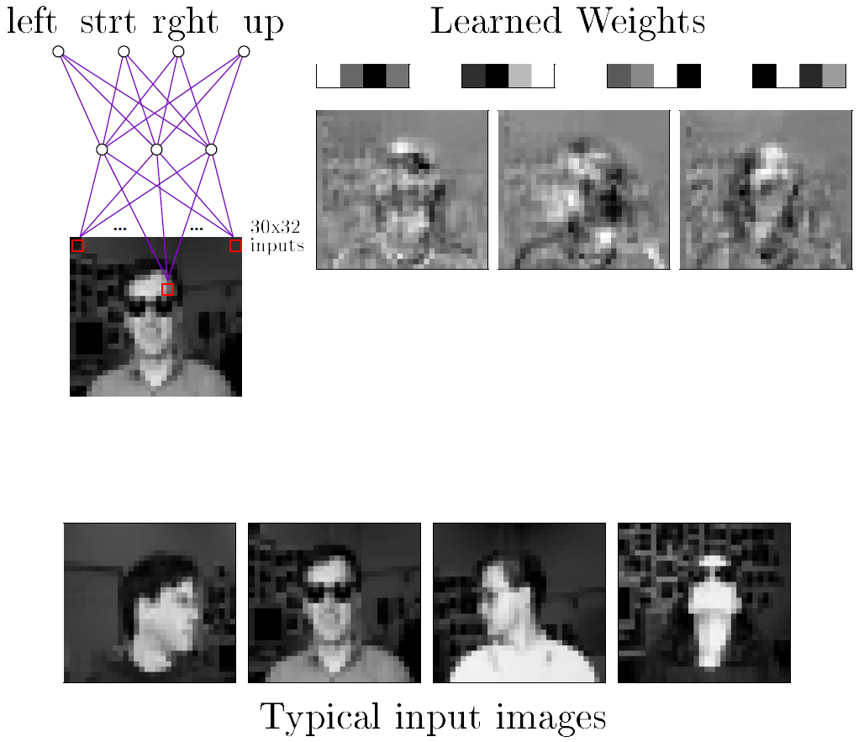
Example: Face pose recognition
Learn the pose of human face: 90% accuracy

Slide 56
Summary
Perceptron
Gradient descent
Multi-layer networks
Backpropagation

